Slide 2
POS Sales Support Overview
Sales Cycle Assistance
Agent/ISO Questions
Agent/ISO Requests
Proposals
POS Features
POSSalesSupport@netevia.com
POS FAQs
Notes:
What is the role of Sales Support
Help the sales people by providing them with the tools they need to successfully complete the Sales Cycle. These tools will range from marketing materials, proposals, and answers to questions about the point of sale system they are selling.
Once a sale has been completed, the Onboarding process must be completed in order to successfully program the point of sale.

Slide 3
POS Sales Support Overview
Onboarding Assistance
GRETA Sales Force
Contract Completion
VAR Sheets
Site Surveys
Netevia HQ Updates
Upload to Shared Drive
Notify GRETA for Implementation
Notes:
What is the role of Sales Support
Help the sales people by providing them with the tools they need to successfully complete the Sales Cycle. These tools will range from marketing materials, proposals, and answers to questions about the point of sale system they are selling.
Once a sale has been completed, the Onboarding process must be completed in order to successfully program the point of sale.

Slide 4
POS Sales Cycle Management
Lead
Discovery
Proposal
Demo
Onboarding
Teach for Differentiation
Deliver Commercial Insight in a rational and emotionally compelling way
Tailor for Resonance
Customize the sales message to individual priorities and goals of the stakeholder group.
Take Control
Guid the customer through the buying process and verify movement
Notes:
Lead: A potential new opportunity that a sales representative has come across. The sales representative will complete a digital lead form that lives on the Netevia website

Slide 5
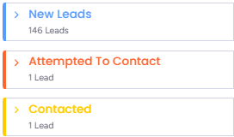
New Leads
Leads
Agent Completes Online Lead Form
Sales Support contacts the sales agent to learn about the lead.
Sales Support will utilize the POS Recommendation tool along with strategic questions to help determine the best solution
Sales Support will work through the POS Proposal Request tool.

Slide 6
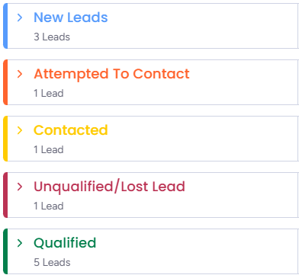
POS Recommendation /Discovery

Slide 7
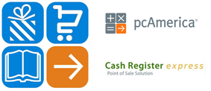
POS System Recommendation
*If you don’t see a pos system that fits an opportunity, don’t worry. We have referral partners that we can introduce you to as needed.

Slide 9
GRETA Key Market Positioning
Ease of Use:
Greta POS is designed to be intuitive and easy to learn, requiring minimal training for staff.
Affordability:
Exclusive pricing through Netevia
Cash Discount Ready:
Dual pricing compliant
Dual Pricing Shelf Tags
Dual pricing electronic shelf tags coming soon
Exclusive & Proprietary:
Fully integrated label printing scale
Customization:
The platform can be customized to fit the specific needs of different businesses, from small corner stores to larger grocery chains.
Cloud-Based Technology:
This ensures easy access and updates, as well as remote management capabilities.
Focus on Small Businesses:
Greta POS highlights its commitment to empowering small businesses by providing them with powerful tools and support.

Slide 10
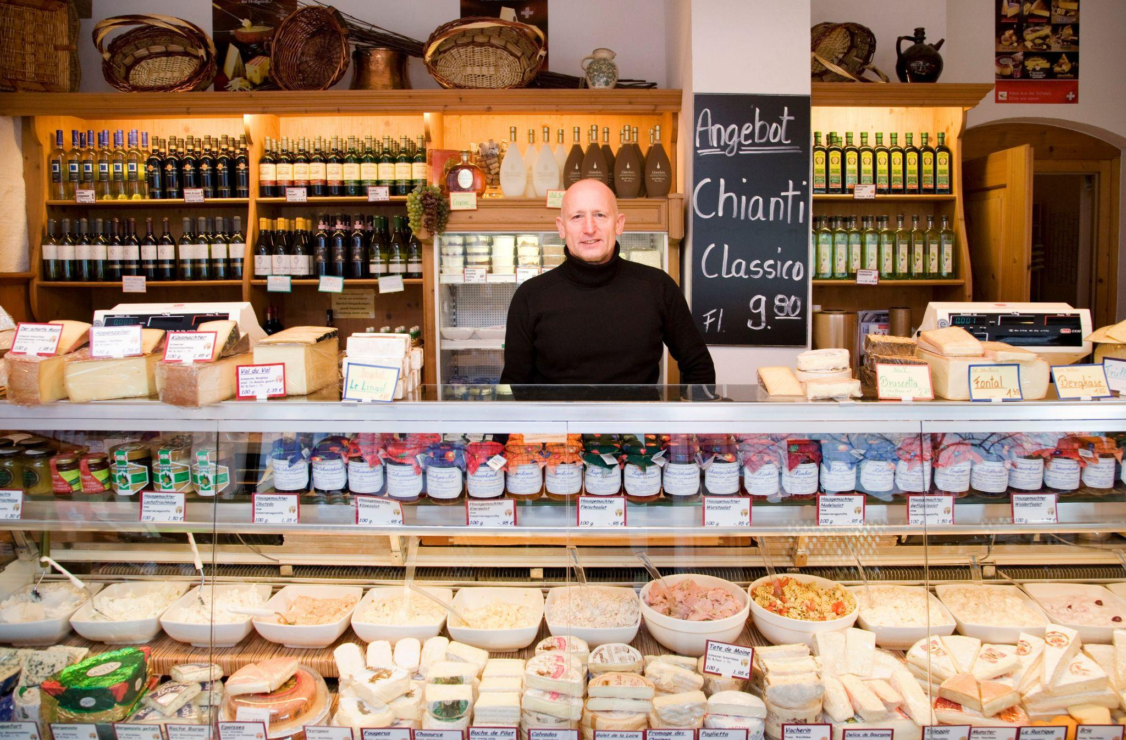
GRETA Independent “Mom & Pop” Specialty Retail Stores
157,000 Small Specialty Retail Stores in the US- IBIS World
Gourmet food stores provide a distinctive shopping experience, offering a wider range of specialty products, personalized service, and premium pricing. They prioritize their product selection, customer experience, and premium pricing above others.
GRETA integrates a point based loyalty program where the customer receives points per product purchased with special discount assignments and a maximum point setup. Loyal customers can accumulate points on purchases that they can use to redeem discounts.
Examples of Gourmet food stores:
Gourmet Grocers
Delicatessens
Speciality Cheese Shops
Health Food Stores
Vegan and Vegetarian Grocers
Spice Shops
Candy Shops
Bakeries

Slide 11
GRETA Ethnic Supermarkets
Ethnic food stores cater to a specific cultural niche within the diverse American market. Customers seek authentic products and flavors, driving demand and allowing for higher profit margins. These stores foster community by becoming a gathering place that strengthens cultural identity. By offering unique selections, they differentiate themselves from traditional grocery stores.
GRETA provides cutting-edge technology solutions at affordable prices, enabling these businesses to streamline operations and compete effectively.
Examples of ethnic food stores:
Asian
Chinese, Japanese, Korean, Indian, Thai
Latin American
Mexican, Cuban, Brazilian
Middle Eastern
Lebanese, Turkish, Israeli, African
European
Polish, Russian, Ukrainian, Mediterranean, Italian, Greek, Spanish

Slide 12
GRETA Convenient Stores and Liquor Stores
49,759 Convenience Stores in the US- IBIS World
46,633 Liquor Stores in the US- IBIS World
C-Stores and liquor stores often sell high-demand products with high profit margins. Their flexible hours and minimal staffing needs keep overhead low. Quick transactions and barcode-based inventory control contribute to efficient operations and increased sales.
GRETA supports Age Verification, Multi-Store Integration, Price Batching, Discounting, Scan Data, vendor management and much more.
Examples of C-Stores & Liquor Stores
Neighborhood Liquor Stores
Liquor Superstores
Specialty Liquor Stores
Wine Shops
Beer Stores
Neighborhood Convenience stores
Non Fuel Integrated Gas Station Convenience Store

Slide 13
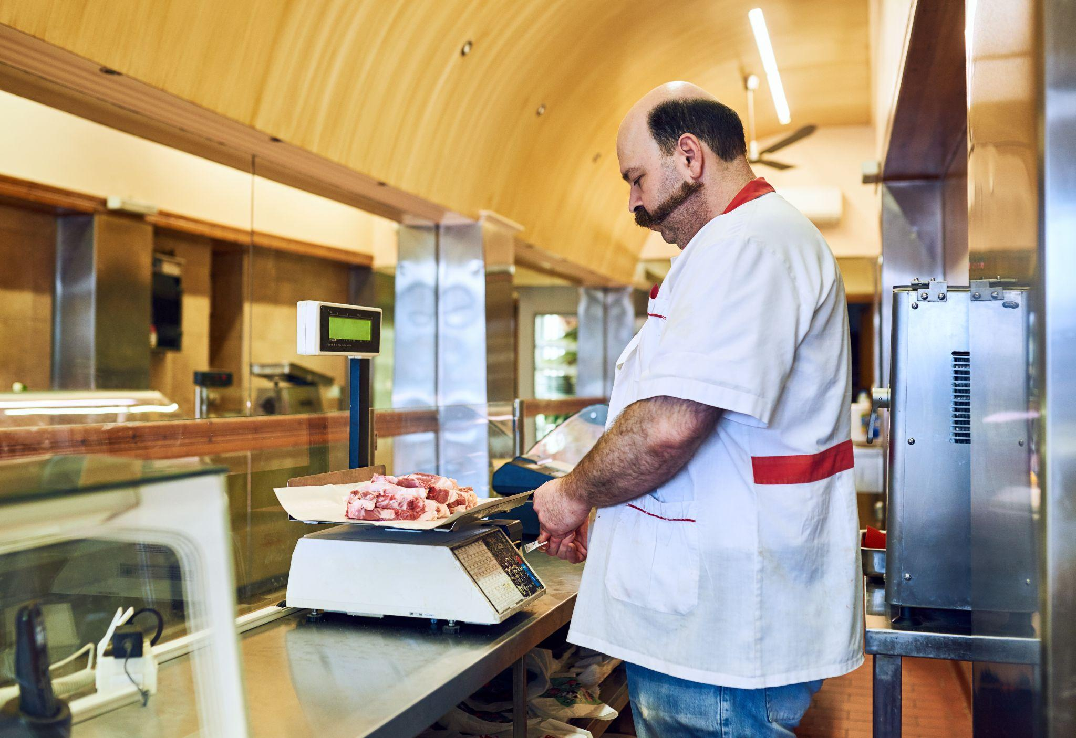
GRETA Meat Markets/Seafood Markets
Meat/Seafood market customers, like those of gourmet grocery stores, are willing to pay a premium for high-quality, fresh meat. This fosters a loyal customer base and ensures long-term sustainability. Many meat markets expand their offerings beyond fresh cuts to include prepared foods and specialty items like sausages and charcuterie.
Retail butcher/seafood shops often rely on scales integrated with their POS systems. Incorrect integration can lead to pricing and inventory errors, causing confusion and impacting sales. GRETA's exclusive scales and proprietary software eliminate these issues, ensuring accurate pricing and inventory management.
Examples of Meat Markets
Traditional Butcher Shops
Specialty Butcher Shops
Charcuterie Shops
Supermarkets
Specialty Meat Markets:
Notes:
Traditional Butcher Shops:
Offer a wide range of cuts from various animals, such as beef, pork, lamb, and poultry.
Traditional shops that specialize in cutting and preparing meat.
Often offer a wide variety of cuts and can provide custom cuts.
May also sell other meat products, such as sausages and cured meats.
Specialty Butcher Shops: Focus on specific types of meat, such as organic, grass-fed, or heritage breed meats.
Charcuterie Shops: Specialize in cured meats, such as salami, prosciutto, and ham.
Supermarkets:
Large grocery stores that sell a variety of food products, including meat.
Typically offer a selection of pre-packaged meat cuts.
Specialty Meat Markets:
Stores that focus on specific types of meat, such as organic, grass-fed, or exotic meats.
May also offer prepared meat dishes and charcuterie.

Slide 14
GRETA Sales Cycle
Discovery
Big Discos create little demos.
Criteria for Powerful Questions:
Remain Open Ended
Drive Toward a specific objective or outcome
Remain Positive in tone and curious in nature
Probe for further analysis
Gain additional information about a topic or situation
Invite other perspectives and opinions

Slide 15
GRETA Sales Cycle
Discovery
Questions that start with Why can make people feel defensive.
Open Ended Questions start with:
What…
How…
When…
Where…
Who…
These questions develop trust, they are perceived as less threatening, and allow for an open response.
Closed Questions start with:
Is/Are…
Do/Did/Does…
Will/Was…
Can…
Has/Have…
Would/Should/Could…
These questions allow for incomplete responses that can be perceived as leading. This may result in incorrect assumptions/conclusions, and discourage full disclosure.

Slide 16
GRETA Sales Cycle
Discovery
A merchant's favorite thing to talk about is themselves
Ask for a guided tour of the business. Leverage the POS features to ask questions along the tour. Focus your questions on the following perspectives:
Customer Perspective
Employee Perspective
Manager Perspective
Owner Perspective

Slide 17
GRETA Sales Cycle
Discovery

Slide 18
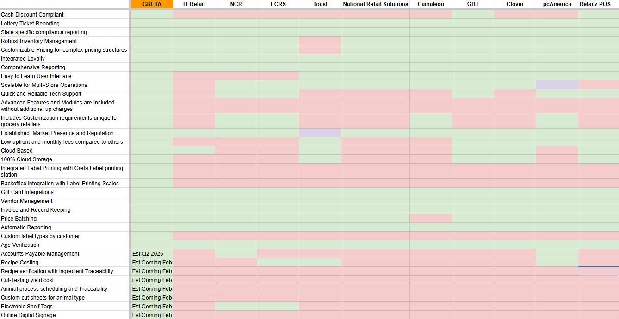
GRETA Competitive Matrix

Slide 19
GRETA ISO Resources
GRETA Specialty Food Store Training
GRETA Slaughterhouse & Retail Butcher Shop Training
GRETA Competitive Matrix
GRETA Pre-Recorded Demo
GRETA’s Countertop Supplier
GRETA Industry Battle Cards (Working with GRETA)
GRETA Competitor Battle Cards (Working with GRETA)
GRETA Pricing Battle Cards (Working with GRETA)
GRETA ISO Leadership Training
GRETA ISO Agent Training Series
GRETA Flyers
Netevia POS Sales Cycle Training
Netevia POS Lead Form
Netevia POS System Recommendation Form
Netevia POS Proposal Request Form Netevia POS Overview

Slide 20
GRETA Sales Cycle
Proposal
The best time to present the proposal is at the end of the Demo.
Sales Agents who are on site for the demo have a much stronger chance of closing the sale on the spot.
Leveraging all of the discovery information to prepare a proposal ahead of the demo sets the Sales Engineer up for Success.

Slide 21
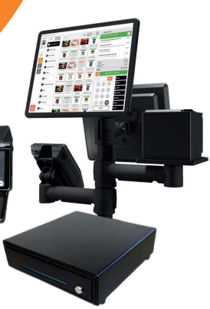
GTM Pricing Promo
Program Details
$999.00 Installation and Training
$29.99 /Month/Bundle (Peripherals sold separately)
Cash Discount or IC+ 1%
Minimum Processing Volume: 25k
Agent Bonus Program (NO DEMO, NO BONUS)
25k Volume $500
50k Volume $1000
75K+ Volume $1500
Bundles DO NOT include Scales or Label Stations
ETF amount of monthlies that are left in the 48 months

Slide 22
All-in-One POS Bundle
Programming, Installation & Training (PIT) | $999 Down
Item | GTM Pricing
1 Station Bundle (No Scale) | $29.99/ Month
2 Station Bundle (No Scale) | $59.99/ Month
1 Station Bundle with Countertop Scale | $59.99/ Month
2 Station Bundle with Countertop Scale | $119.99/ Month
60 lb Countertop Scale (Optional)

Slide 23
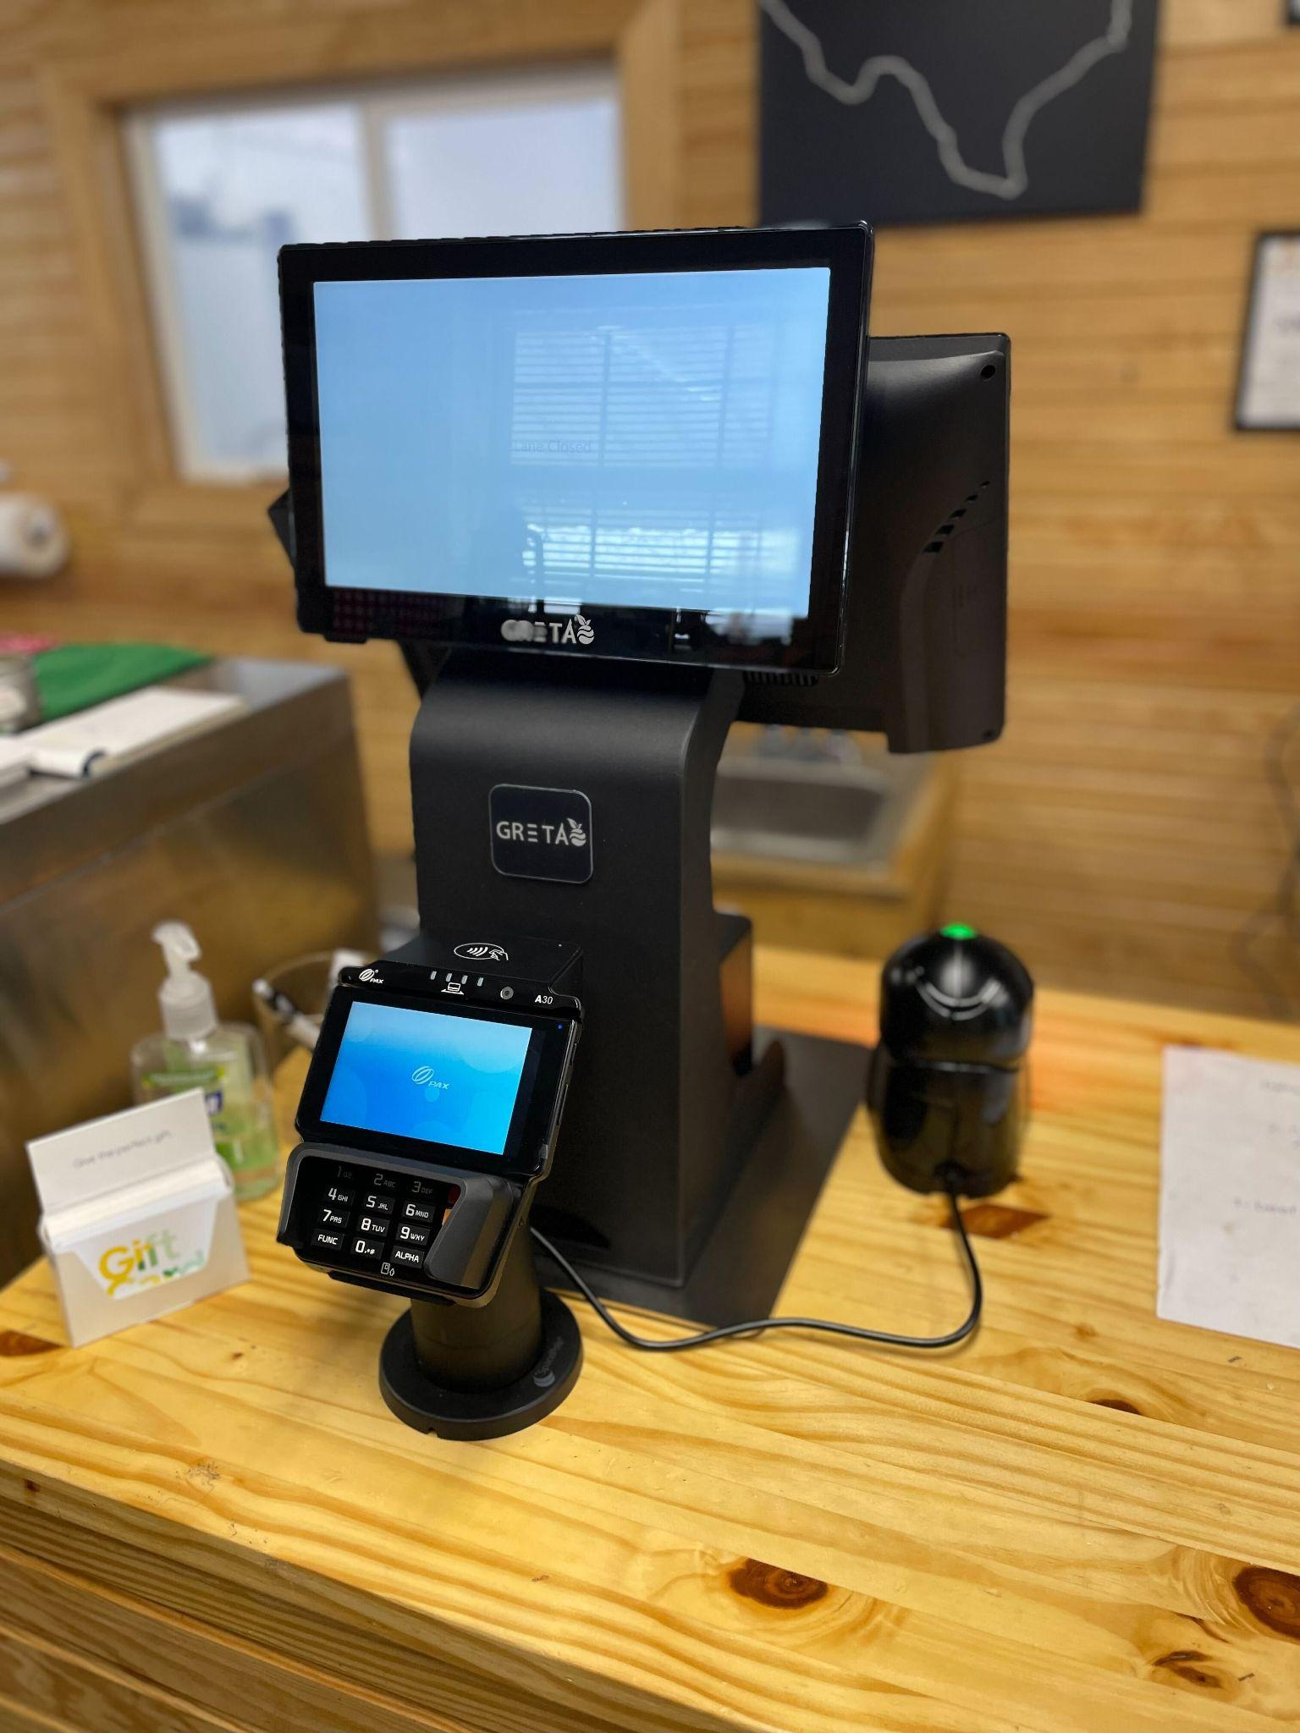
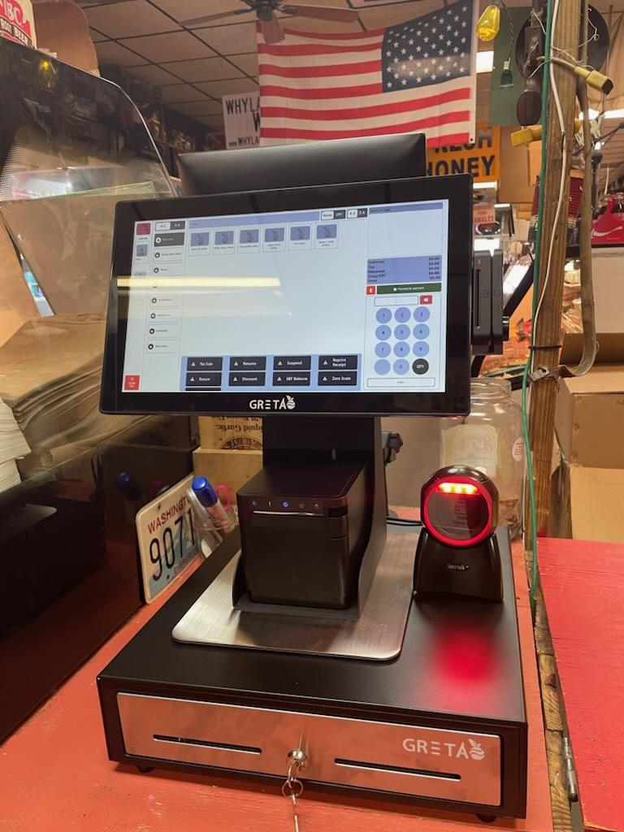

Slide 24
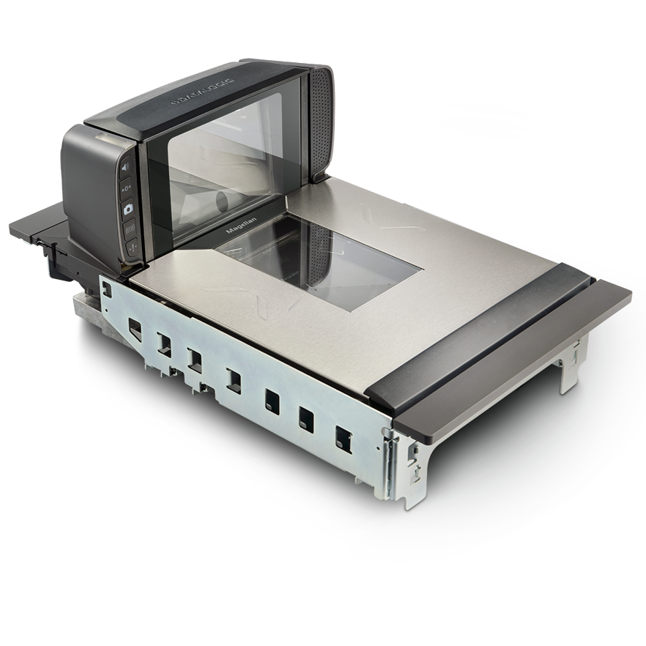
GRETA Single Lane POS
PIT | $999 Down
Item | GTM Pricing
1 Station Bundle (No Scale) | $29.99/ Month
2 Station Bundle (No Scale) | $59.99/ Month
1 Station Bundle w/Countertop Scale | $59.99/ Month
2 Station Bundle w/Countertop Scales | $119.99/ Month
1 Station Bundle w/In-Counter Scales | $79.99/ Month
2 Station Bundle w/In-Counter Scales | $159.99/ Month
In-Counter Scanner Scale
(Optional)
60 lb Countertop Scale (Optional)

Slide 25
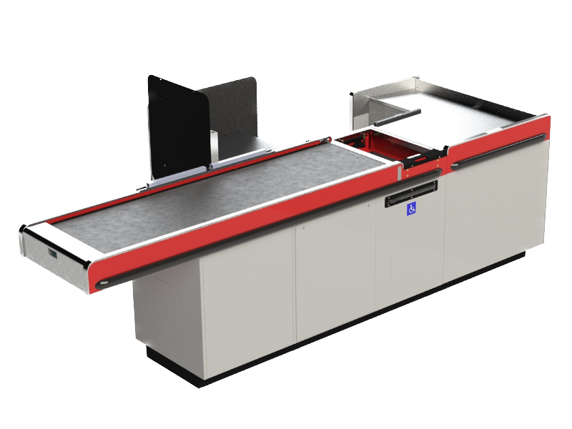
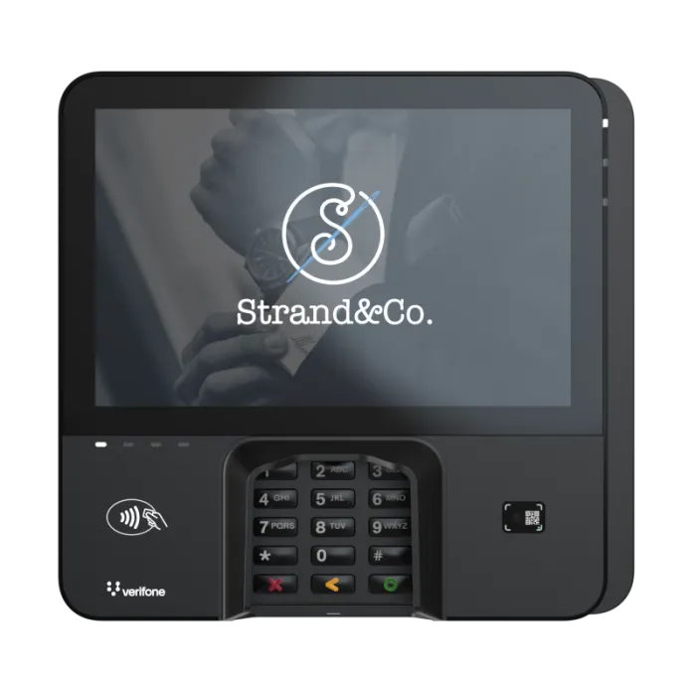
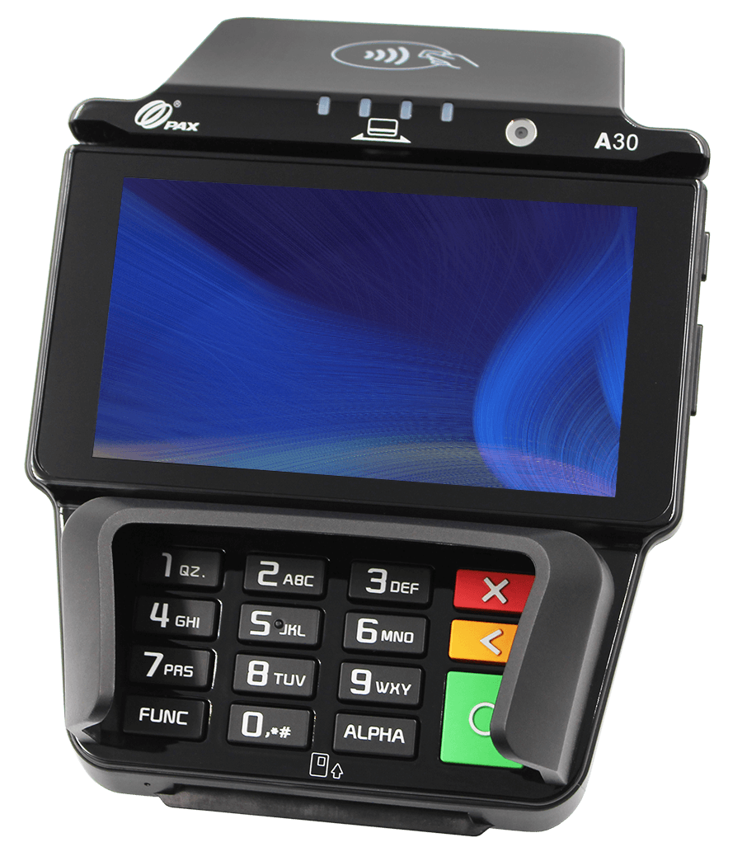
MULTI-LANE
In-Counter Scale
Customer Facing PAX A30
PAX ARIES8
Verifone M440
*Coming Soon*

Slide 26
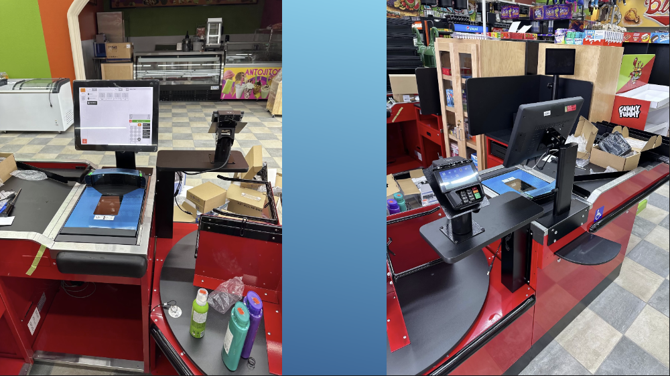

Slide 27
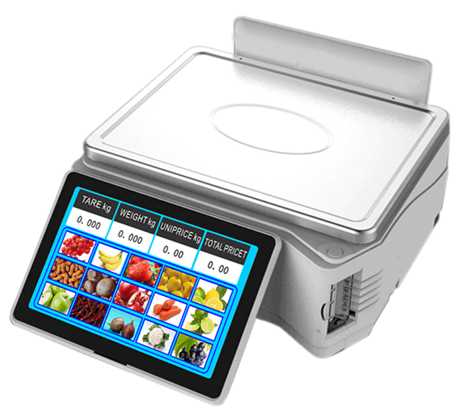
FEATURES
FUNCTIONALITIES:
Butcher Facing 15” Display
10” Customer Facing Display
Side Label printer
30 lb capacity
Windows based operating system
Capacitive touch, Flushed touchscreen
Department structure
Item categorization
Pagination capabilities
Product image
Customer tare, price and total charge disclosure
Cloud managed
Price embedded & weight embedded barcode printing.
Cumulative label printing
Item | Monthly Pricing
Label Printing Scale TS5 | $49.99/ Month

Slide 28
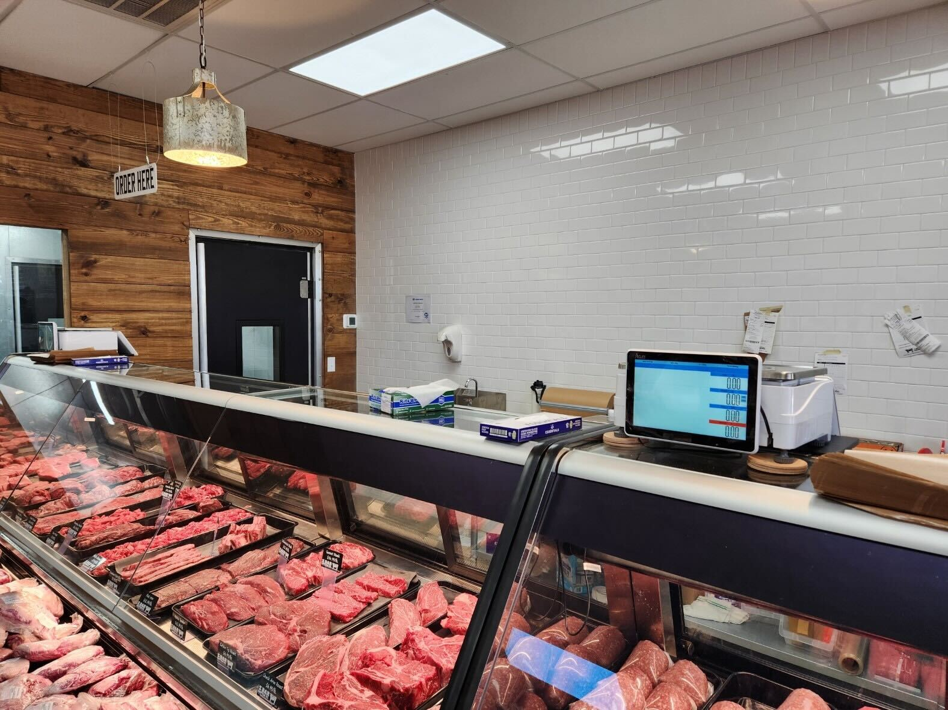

Slide 29
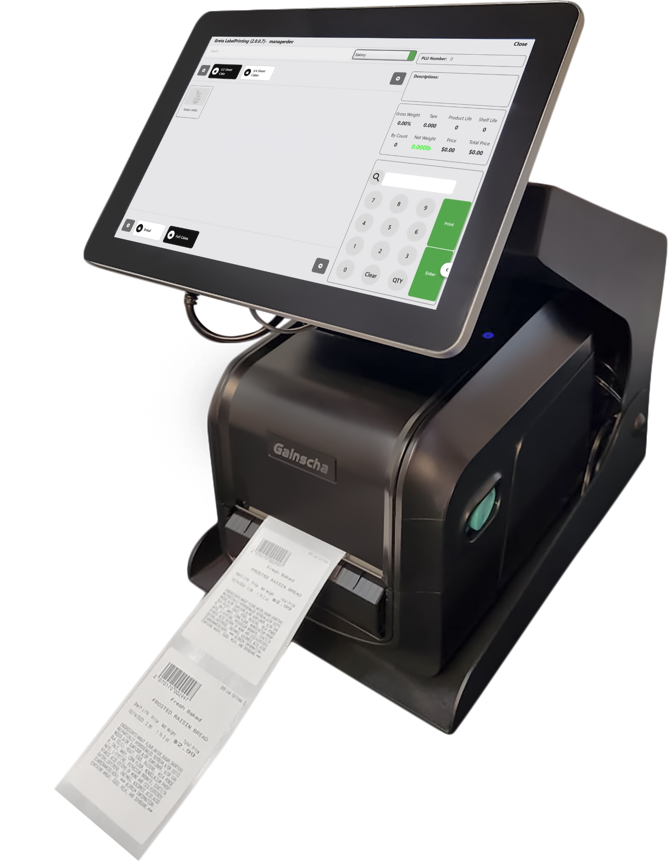
FEATURES
FUNCTIONALITIES:
User Facing 15” Display
Thermal production Label printer
Windows Based OS
Metal Housing for rough kitchen environments.
Optional 60 lbs Scale
Optional Industrial grade label printer
Flushed, Capacitive Touchscreen
Tare values assigned
Random, Fixed and By Count PLU type printing.
Departments Structure
Item Categorization
Inventory updater on production
PLU finder
Label Streaming
Tare & Print option
Multiple label options, including continuous label stock
Optional 60 lbs scale
Item | Monthly Pricing
Label Printing Station (No Scale) | $49.99/ Month
Label Printing Station (With Scale) | $79.99/ Month

Slide 30
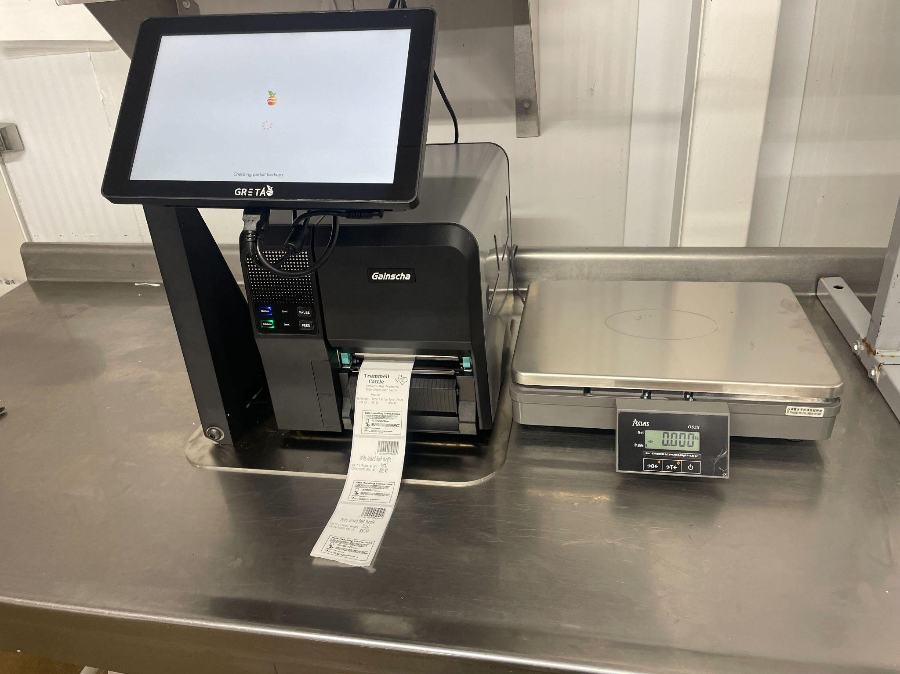

Slide 31
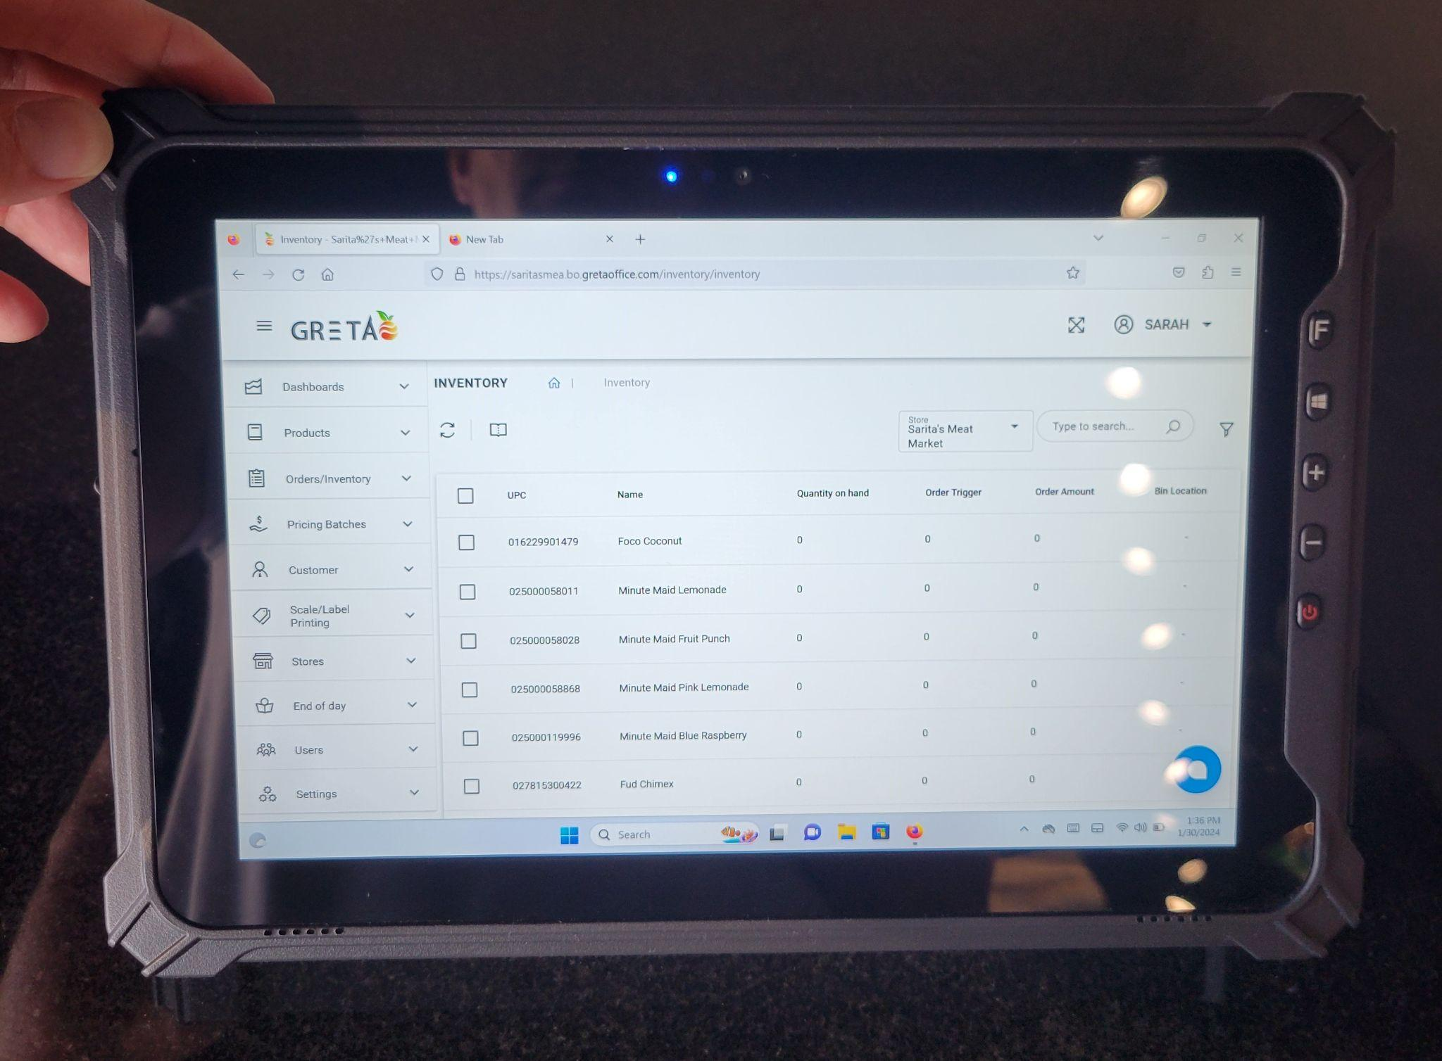
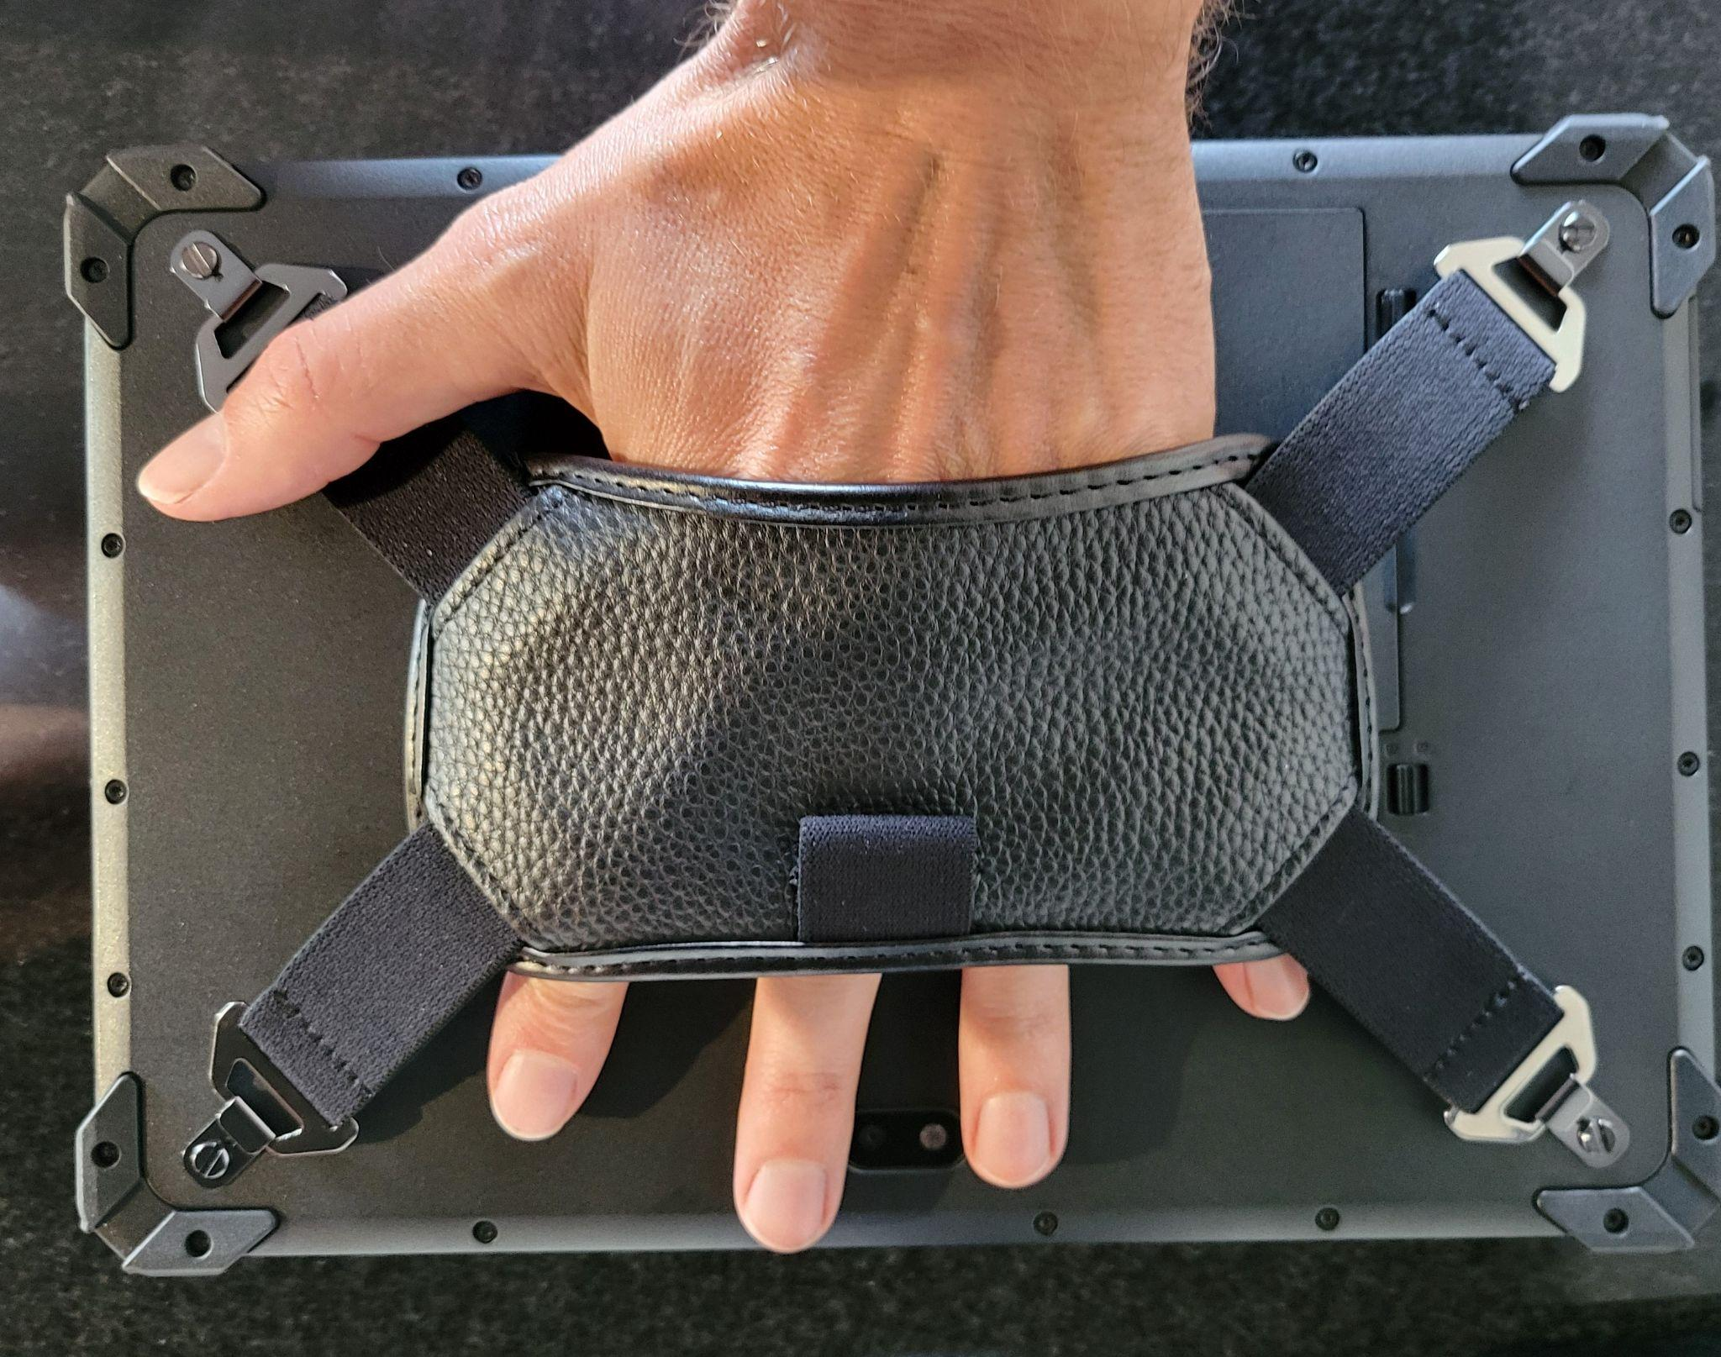
INVENTORY TABLET
Item | Monthly Pricing
7” Inventory Tablet | $19.99/ Month
10” Inventory Tablet | $29.99/ Month

Slide 32
Add on Hardware
Item | Monthly Pricing
Label Printer LP1 | 14.99/ Month
Shelf Tag Printer GA3406 | $9.99/ Month
USB/BT Scanner BT40D | $4.99/ Month
Cash Drawer- ECH410 | $4.99/ Month
PAX A30 | $14.99/ Month
60lb Weight Scale-OS2C | $29.99/ Month
GRETA Digital Computer | $9.99/ Month
10” Inventory Tablet I17J | $29.99/ Month
7” Inventory Tablet I62H | $19.99/ Month
Extra CD Till E410I | $1.99/ Month
2D Barcode Scan OD | $5.99/ Month
2D Presentation Scan OD4600 | $7.99/ Month
GRETA Label Print Scale TS5 | $49.99/ Month
GRETA Label Print Scale LS5 | $39.99/ Month

Slide 33
GRETA Sales Cycle
Demo
Sales agents should let the sales engineer do their presentation without interruption.
Sales agents should not ask questions during the presentation, especially ones they do not know the answer too.
Sales engineers play a crucial role in closing sales by providing technical expertise and bridging the gap between sales and engineering teams. They showcase the product's features and benefits through compelling demonstrations, highlighting how it solves customer problems. engineers play a vital role in building trust, credibility, and ultimately closing deals.
Notes:
* **Technical Consultation:** They provide in-depth technical advice and guidance to customers, helping them understand complex technical concepts. * **Problem-Solving:** They identify and resolve technical challenges or objections raised by customers, ensuring a smooth sales process. * **Customization:** They work with customers to customize solutions to meet their specific needs, demonstrating flexibility and adaptability. * **Collaboration with Sales Teams:** They collaborate closely with sales teams to develop effective sales strategies and create compelling sales presentations. * **Post-Sales Support:** They provide ongoing technical support to customers, ensuring customer satisfaction and building long-term relationships. By providing technical expertise and addressing customer concerns, sales

Slide 34
GRETA Sales Cycle
Onboarding
Setting expectations with the merchant throughout the sales cycle will make this process easier.
The sales support team has a comprehensive checklist of what needs to be collected to move the deal forward to implementation.
Onboarding is perhaps the most important part of the implementation process. Without collection of the information we need and collaboration with the merchant we will not be able to meet our installation timeline.
Notes:
* **Technical Consultation:** They provide in-depth technical advice and guidance to customers, helping them understand complex technical concepts. * **Problem-Solving:** They identify and resolve technical challenges or objections raised by customers, ensuring a smooth sales process. * **Customization:** They work with customers to customize solutions to meet their specific needs, demonstrating flexibility and adaptability. * **Collaboration with Sales Teams:** They collaborate closely with sales teams to develop effective sales strategies and create compelling sales presentations. * **Post-Sales Support:** They provide ongoing technical support to customers, ensuring customer satisfaction and building long-term relationships. By providing technical expertise and addressing customer concerns, sales

Slide 35
POS Sales Cycle
Upload Proposals & Discovery Info
Lead
Lead Qualification
Discovery
Proposal
Sales Force
Demo
Onboarding
Data Collection and Formatting
(Biggest reason for delays)
Lead Qualification Form
Proposal Request Form
Notes:
Lead: A potential new opportunity that a sales representative has come across. The sales representative will complete a digital lead form that lives on the Netevia website

Slide 36
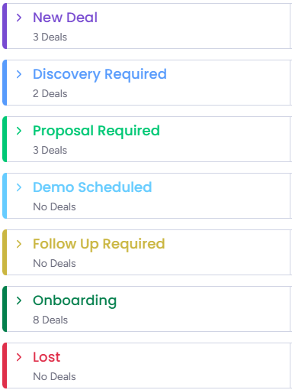
Sales Cycle Assistance

Slide 37
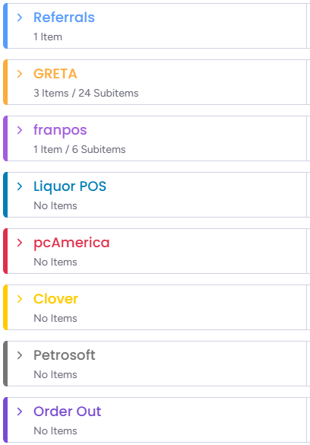
Onboarding Assistance
This is the biggest cause of delays, the faster we are able to collect the information we need, the faster we can program, install and train.

Slide 38
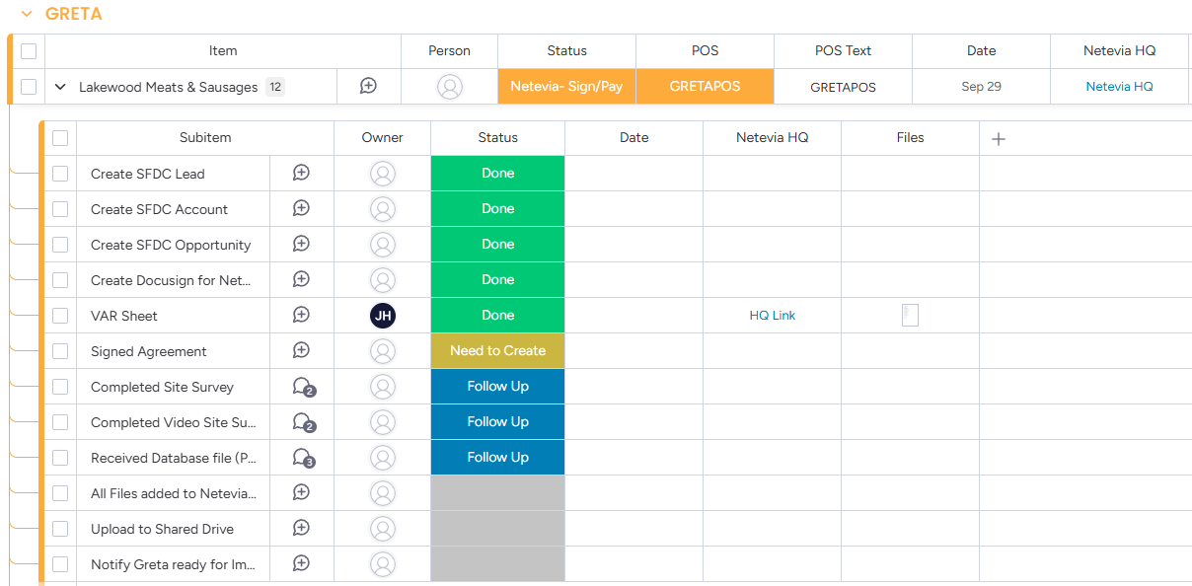
Onboarding Assistance

Slide 39
POS Journey
Step 0
Step 1
Step 2
Step 3
Step 4
Sales Agent identifies a POS opportunity and submits online lead form
Sales Support receives the lead on Monday.com and calls the Sales Agent to qualify the lead
POS SS builds proposal, assists with scheduling the demo. SS Preps SE with draft proposal and notes
Sales Engineer (SE) performs Disco, Demo, and presents proposal. SE turns sale over to Agent to close.
Sales Support helps the Agent with Discovery and the Proposal Site Survey
Step 5
Step 6A
Step 7
Step 8
Step 9
Sales Agent Closes the sale. Or SS assists in continued follow up until closed or lost.
SS Collects Docs for Onboarding
SS hands the deal over to GRETA for Implementation
GRETA programs the system and schedules installation
GRETA installs system and provides ongoing tech support
Step 6B
SS Formats the database for implementation

Slide 40
IMPLEMENTATION TIME FRAME
Week 1
(Back office build)
Week 2
(Inventory Review Call)
Week 4
(Shipping Period)
Week 2
(Inventory build)
Week 3
(Equipment order and Configuration)
Week 5
(installation & Training)
Disclosure:*As GRETA™ relies on the data in the system being accurate to perform at it designed best, please be mindful that implementation can be delayed if we do not have the correct information for equipment, item file, locations etc. We recommend 4-6 weeks to installation from the moment payment is collected.
Notes:
Week 1 (Back-office Build) After financing has completed the order for GRETA™ deployment & payment has been collected we will build Customer Databases in the cloud for all locations along with store configuration. *A signed purchase order is required in order to to begin implementation.
Week 2 (Inventory build)
Menu file, departments, categories, discounts etc will be built in the customers back office. *We require an inventory file for this stage of implementation in .CSV format. Failure to provide inventory file will cause delays in installation.
Week 2 Inventory Review Call: Inventory review call with client to get clearance to deploy. *Required to deploy systems
Week 3 (Equipment order and Configuration)
Equipment ordered from warehouse, equipment sync, download and configuration for all applications. POS, LPS, Scale Comm.
Week 4 (Shipping Period)
Shipping is usually about 7 business days. Expedited shipping is available on case by case at current shipping rates
Week 4 (Shipping Period)
Shipping is usually about 7 business days. Expedited shipping is available on case by case at current shipping rates
Week 5 (installation & Training)
After equipment arrives, installers will install equipment and get it ready for training. Training will be done virtually or in person based on the client’s preference

