Slide 2
GRETA Key Market Positioning
Ease of Use:
Greta POS is designed to be intuitive and easy to learn, requiring minimal training for staff.
Affordability:
Exclusive pricing through Netevia
Cash Discount Ready:
Dual pricing compliant
Dual Pricing Shelf Tags
Dual pricing electronic shelf tags coming soon
Exclusive & Proprietary:
Fully integrated label printing scale
Customization:
The platform can be customized to fit the specific needs of different businesses, from small corner stores to larger grocery chains.
Cloud-Based Technology:
This ensures easy access and updates, as well as remote management capabilities.
Focus on Small Businesses:
Greta POS highlights its commitment to empowering small businesses by providing them with powerful tools and support.

Slide 3
GRETA Independent “Mom & Pop” Specialty Retail Stores
157,000 Small Specialty Retail Stores in the US- IBIS World
Average Volume: we don't want 25k merchants competing in this space
Gourmet food stores provide a distinctive shopping experience, offering a wider range of specialty products, personalized service, and premium pricing. They prioritize their product selection, customer experience, and premium pricing above others.
Beyond the scale integrations and GRETA's ability to support these merchants; the customer loyalty created by these experiences and offerings make GRETA a perfect solution for this market.
Some Examples of Gourmet food stores include:
Gourmet Grocers
Delicatessens
Speciality Cheese Shops
Health Food Stores
Vegan and Vegetarian Grocers
Spice Shops
Candy Shops
Bakeries
Be Mindful: Not every business in this category will be a fit. GRETA may not work for merchants processing less than 25K

Slide 4
GRETA Ethnic Supermarkets
16,157 Businesses in the US- IBIS World
Ethnic food stores cater to a specific cultural niche within the diverse American market. Customers seek authentic products and flavors, driving demand and allowing for higher profit margins. These stores foster community by becoming a gathering place that strengthens cultural identity. By offering unique selections, they differentiate themselves from traditional grocery stores.
Ethnic markets, despite their smaller size, often require similar operational capabilities as traditional grocery stores. GRETA can provide cutting-edge technology solutions at affordable prices, enabling these businesses to streamline operations and compete effectively.
Examples of ethnic food stores include:
Asian
Chinese, Japanese, Korean, Indian, Thai
Latin American
Mexican, Cuban, Brazilian
Middle Eastern
Lebanese, Turkish, Israeli, African
European
Polish, Russian, Ukrainian, Mediterranean, Italian, Greek, Spanish
GRETA’s Sweet Spot: This is the best types of merchants to focus on.

Slide 5
GRETA Convenient Stores and Liquor Stores
49,759 Convenience Stores in the US- IBIS World
46,633 Liquor Stores in the US- IBIS World
C-Stores and liquor stores often sell high-demand products with high profit margins. Their flexible hours and minimal staffing needs keep overhead low. Quick transactions and barcode-based inventory control contribute to efficient operations and increased sales.
C-Stores and liquor stores often sell age-restricted products like cigarettes and alcohol. Integrating these products with a POS system like GRETA can streamline age verification and potentially unlock pricing incentives from suppliers that use integrations like Scan Data. GRETA's robust inventory management features further enhance efficiency and accuracy.
Examples of C-Stores Liquor Store
Neighborhood Liquor Stores
Liquor Superstores
Specialty Liquor Stores
Wine Shops
Beer Stores
Neighborhood Convenience stores
Non Fuel Integrated Gas Station Convenience Store
Scan Data integration coming in January.

Slide 6
GRETA Meat Markets/Seafood Markets
GRETA supports this category very well!
8,619 Meat Markets nationwide- IBIS World
4,601 Fish and Seafood Markets nationwide- IBIS World
Meat/Seafood market customers, like those of gourmet grocery stores, are willing to pay a premium for high-quality, fresh meat. This fosters a loyal customer base and ensures long-term sustainability. Many meat markets expand their offerings beyond fresh cuts to include prepared foods and specialty items like sausages and charcuterie.
Retail butcher/seafood shops often rely on scales integrated with their POS systems. Incorrect integration can lead to pricing and inventory errors, causing confusion and impacting sales. GRETA's exclusive scales and proprietary software eliminate these issues, ensuring accurate pricing and inventory management.
Examples of Meat Markets
Traditional Butcher Shops:
Offer a wide range of cuts from various animals, such as beef, pork, lamb, and poultry.
Traditional shops that specialize in cutting and preparing meat.
Often offer a wide variety of cuts and can provide custom cuts.
May also sell other meat products, such as sausages and cured meats.
Specialty Butcher Shops: Focus on specific types of meat, such as organic, grass-fed, or heritage breed meats.
Charcuterie Shops: Specialize in cured meats, such as salami, prosciutto, and ham.
Supermarkets:
Large grocery stores that sell a variety of food products, including meat.
Typically offer a selection of pre-packaged meat cuts.
Specialty Meat Markets:
Stores that focus on specific types of meat, such as organic, grass-fed, or exotic meats.
May also offer prepared meat dishes and charcuterie.

Slide 7
GRETA ISO Resources
Sales Support Tools:
Sales Support Training-Day 1
Sales Support Training-Day 2
Sales Support Training-Day 3
Sales Support Training-Day 4
Monday CRM
Netevia HQ- POS Sales Support
Nextiva Phone system- POS Sales Support Group
GRETA Proposal Guide-
GRETA Sales Cycle Email Templates
GRETA FAQs
GRETA Demo Calendar
English Primary
English Backup
Spanish
GRETA Salesforce
GRETA New Merchant Template Folder
GRETA Proposal Tool
GRETA Database Onboarding Hub
GRETA Pre-Install Checklist
GRETA Welcome Call Calendar

Slide 8
GRETA ISO Resources
GRETA Specialty Food Store Training
GRETA Slaughterhouse & Retail Butcher Shop Training
GRETA Competitive Matrix
GRETA Pre-Recorded Demo
GRETA Industry Battle Cards (Working with GRETA)
GRETA Competitor Battle Cards (Working with GRETA)
GRETA Pricing Battle Cards (Working with GRETA)
GRETA ISO Leadership Training
GRETA ISO Agent Training Series
GRETA Flyers
Netevia POS Sales Cycle Training
Netevia POS Lead Form
Netevia POS System Recommendation Form
Netevia POS Proposal Request Form Netevia POS Overview

Slide 9
GRETA Sales Cycle
Lead
Discovery
Proposal
Demo
Onboarding
Sales agents love to “show up and throw up” solution selling requires a shift in behavior to compel the merchant to take action. Instead, sales agents should:
Teach for Differentiation
Deliver Commercial Insight in a rational and emotionally compelling way
Tailor for Resonance
Customize the sales message to individual priorities and goals of the stakeholder group.
Take Control
Guid the customer through the buying process and verify movement

Slide 10
GRETA Sales Cycle
Leads
53% of the sale is driven by the Sales Experience. - Gartner analysis.
Merchants buy from sales professionals that offer unique, valuable perspectives on their specific market. They are looking for:
Help navigate alternatives
Help to avoid potential risks
Education on new issues and outcomes
Companies that are easy to buy from.

Slide 11
GRETA Sales Cycle
Discovery
Big Discos create little demos.
Sales agents love to “show up and throw up” solution selling requires a shift in behavior to compel the merchant to take action. A great way to do this is to ask powerful questions.
Criteria for Powerful Questions:
Remain Open Ended
Drive Toward a specific objective or outcome
Remain Positive in tone and curious in nature
Probe for further analysis
Gain additional information about a topic or situation
Invite other perspectives and opinions

Slide 12
GRETA Sales Cycle
Discovery
Questions that start with Why can make people feel defensive.
Open Ended Questions start with:
What…
How…
When…
Where…
Who…
These questions develop trust, they are perceived as less threatening, and allow for an open response.
Closed Questions start with:
Is/Are…
Do/Did/Does…
Will/Was…
Can…
Has/Have…
Would/Should/Could…
These questions allow for incomplete responses that can be perceived as leading. This may result in incorrect assumptions/conclusions, and discourage full disclosure.

Slide 13
GRETA Sales Cycle
Discovery
A merchant's favorite thing to talk about is themselves
Ask for a guided tour of the business. Leverage the POS features to ask questions along the tour. Focus your questions on the following perspectives:
Customer Perspective
Employee Perspective
Manager Perspective
Owner Perspective

Slide 14
GRETA Sales Cycle
Proposal
The best time to present the proposal is at the end of the Demo.
Sales Agents who are on site for the demo have a much stronger chance of closing the sale on the spot.
Leveraging all of the discovery information to prepare a proposal ahead of the demo sets the Sales Engineer up for Success. If a successful discovery was performed the Merchant will be excited to learn about the product from the product expert.
At the end of the demo the merchant will ask about the pricing. The Sales Engineer is trained to present the value of each line item making the sale easy to close.

Slide 15
GRETA Sales Cycle
Demo
Sales agents should let the sales engineer do their presentation without interruption.
Sales agents should not ask questions during the presentation, especially ones they do not know the answer too.
Sales engineers play a crucial role in closing sales by providing technical expertise and bridging the gap between sales and engineering teams. They showcase the product's features and benefits through compelling demonstrations, highlighting how it solves customer problems. engineers play a vital role in building trust, credibility, and ultimately closing deals.
Notes:
* **Technical Consultation:** They provide in-depth technical advice and guidance to customers, helping them understand complex technical concepts. * **Problem-Solving:** They identify and resolve technical challenges or objections raised by customers, ensuring a smooth sales process. * **Customization:** They work with customers to customize solutions to meet their specific needs, demonstrating flexibility and adaptability. * **Collaboration with Sales Teams:** They collaborate closely with sales teams to develop effective sales strategies and create compelling sales presentations. * **Post-Sales Support:** They provide ongoing technical support to customers, ensuring customer satisfaction and building long-term relationships. By providing technical expertise and addressing customer concerns, sales

Slide 16
GRETA Sales Cycle
Onboarding
Setting expectations with the merchant throughout the sales cycle will make this process easier.
The sales support team has a comprehensive checklist of what needs to be collected to move the deal forward to implementation.
$999 Down will help with this
Onboarding is perhaps the most important part of the sales process. Without collection of the information we need and collaboration with the merchant we will not be able to meet our installation timeline.
Notes:
* **Technical Consultation:** They provide in-depth technical advice and guidance to customers, helping them understand complex technical concepts. * **Problem-Solving:** They identify and resolve technical challenges or objections raised by customers, ensuring a smooth sales process. * **Customization:** They work with customers to customize solutions to meet their specific needs, demonstrating flexibility and adaptability. * **Collaboration with Sales Teams:** They collaborate closely with sales teams to develop effective sales strategies and create compelling sales presentations. * **Post-Sales Support:** They provide ongoing technical support to customers, ensuring customer satisfaction and building long-term relationships. By providing technical expertise and addressing customer concerns, sales

Slide 17
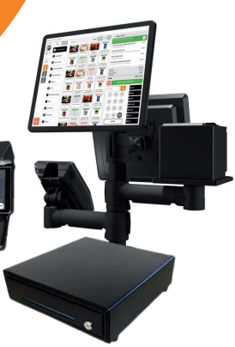
GTM Pricing Promo
Program Details
$999.00 Installation and Training
$29.99 /Month/Bundle (Peripherals sold separately)
Bundles DO NOT include Scales or Label Stations
Cash Discount or IC+ 1%
50/50 Agent/ISO Processing Split
Minimum Processing Volume: 25k
ISO to pay Netevia Monthly
Agent Bonus Program
25k Volume $500
50k Volume $1000
75K+ Volume $1500
ETF amount of monthlies that are left in the 48 months

Slide 18
All-in-One POS Bundle
Programming, Installation & Training (PIT) | $999 Down
Item | GTM Pricing
1 Station Bundle (No Scale) | $29.99/ Month
2 Station Bundle (No Scale) | $59.99/ Month
1 Station Bundle with Countertop Scale | $59.99/ Month
2 Station Bundle with Countertop Scale | $119.99/ Month
60 lb Countertop Scale (Optional)

Slide 19
All-in-One POS Bundle
Programming, Installation & Training (PIT) | $999 Down
Item | Monthly Pricing to Netevia
1 Station Bundle (No Scale) | $149.99/ Month
2 Station Bundle (No Scale) | $239.99/ Month
1 Station Bundle with Countertop Scale | $179.99/ Month
2 Station Bundle with Countertop Scale | $299.99/ Month
60 lb Countertop Scale (Optional)

Slide 20
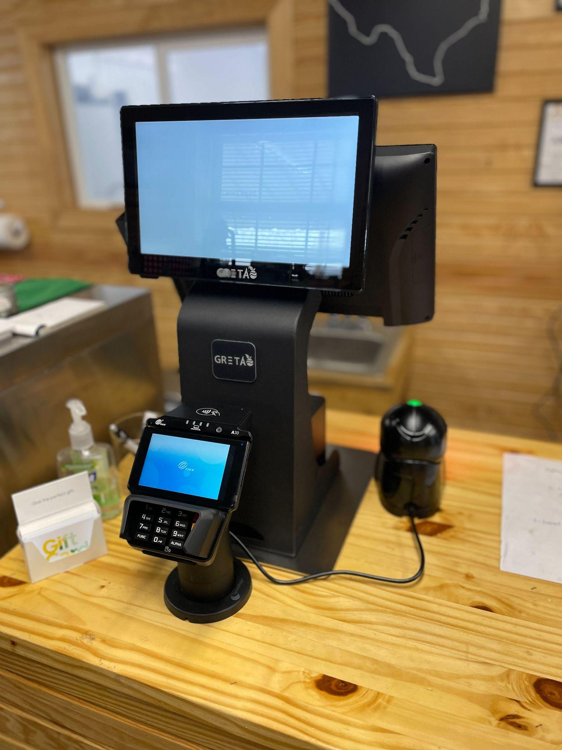
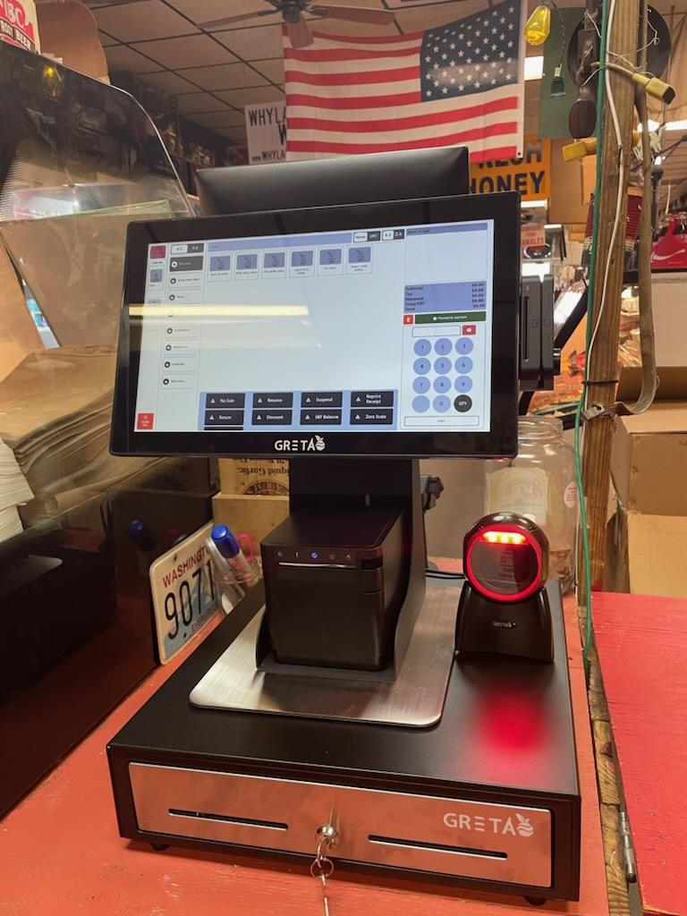

Slide 21
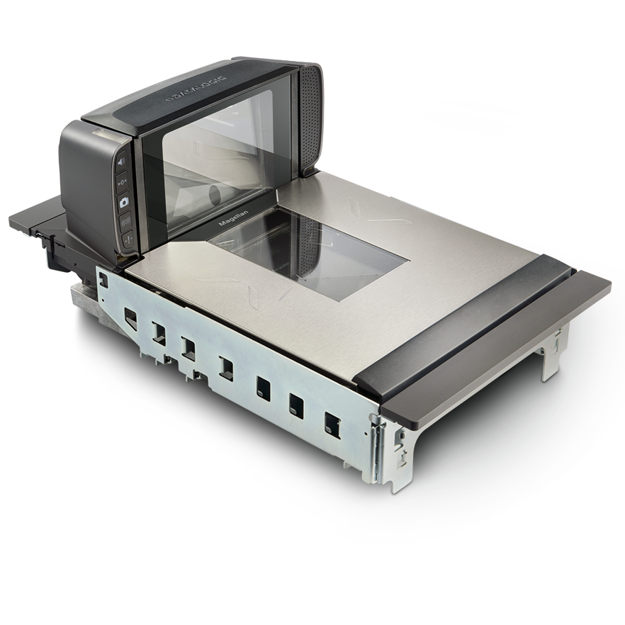
GRETA Single Lane POS
PIT | $999 Down
Item | GTM Pricing
1 Station Bundle (No Scale) | $29.99/ Month
2 Station Bundle (No Scale) | $59.99/ Month
1 Station Bundle w/Countertop Scale | $59.99/ Month
2 Station Bundle w/Countertop Scales | $119.99/ Month
1 Station Bundle w/In-Counter Scales | $79.99/ Month
2 Station Bundle w/In-Counter Scales | $159.99/ Month
In-Counter Scanner Scale
(Optional)
60 lb Countertop Scale (Optional)

Slide 22
GRETA Single Lane POS
PIT | $999 Down
Item | Monthly Pricing to Netevia
1 Station Bundle (No Scale) | $149.99/ Month
2 Station Bundle (No Scale) | $239.99/ Month
1 Station Bundle w/Countertop Scale | $179.99/ Month
2 Station Bundle w/Countertop Scales | $299.99/ Month
1 Station Bundle w/In-Counter Scales | $199.99/ Month
2 Station Bundle w/In-Counter Scales | $339.99/ Month
In-Counter Scanner Scale
(Optional)
60 lb Countertop Scale (Optional)

Slide 23
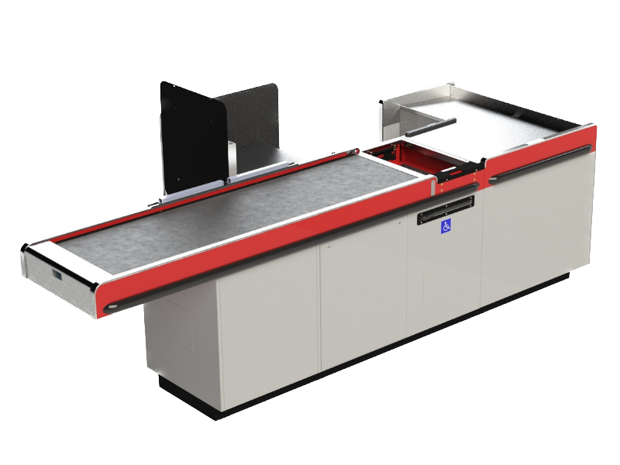
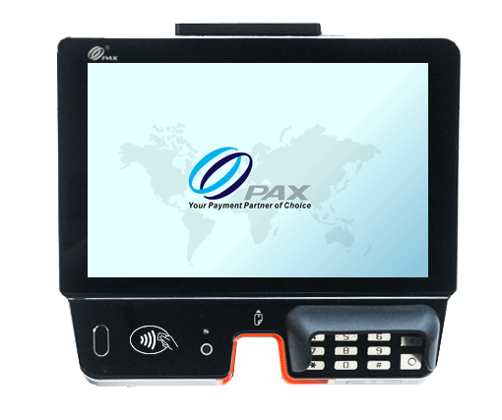
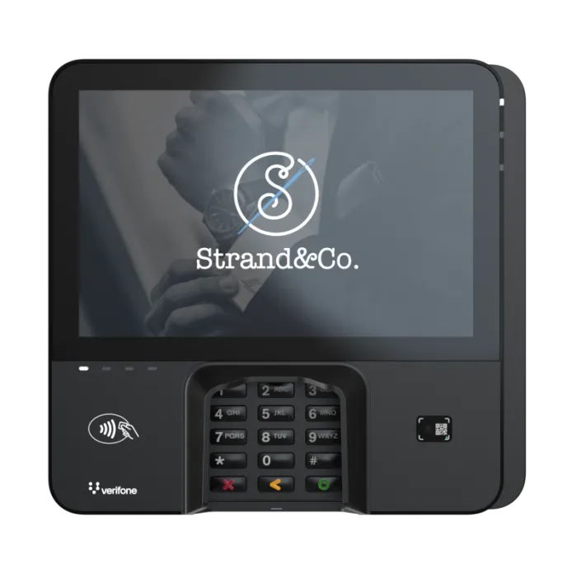
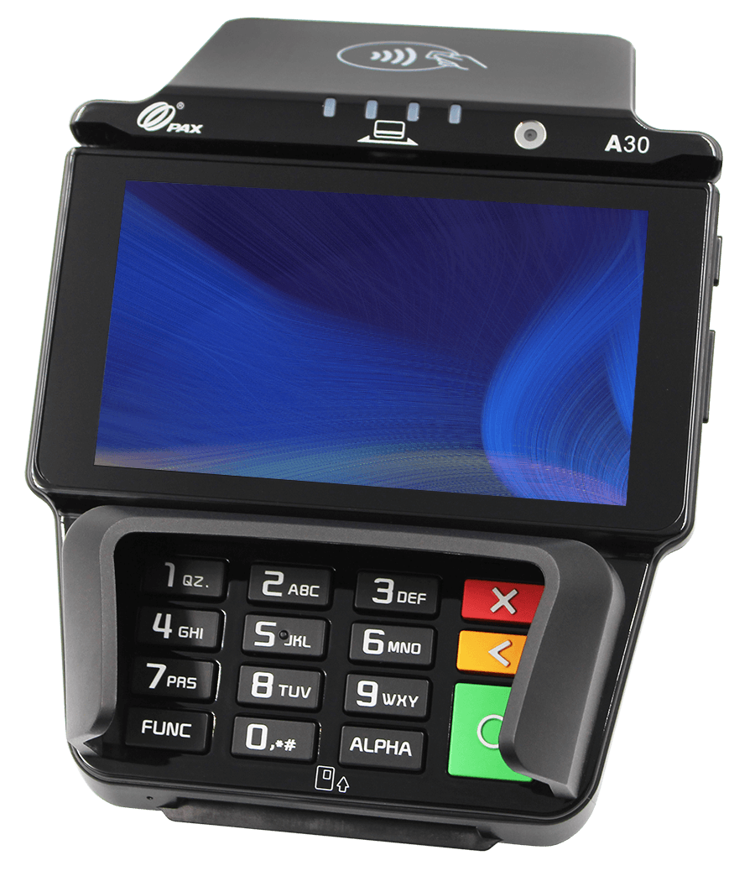
MULTI-LANE
In-Counter Scale
Customer Facing PAX A30
PAX ARIES8
Verifone M440
*Coming Soon*

Slide 24
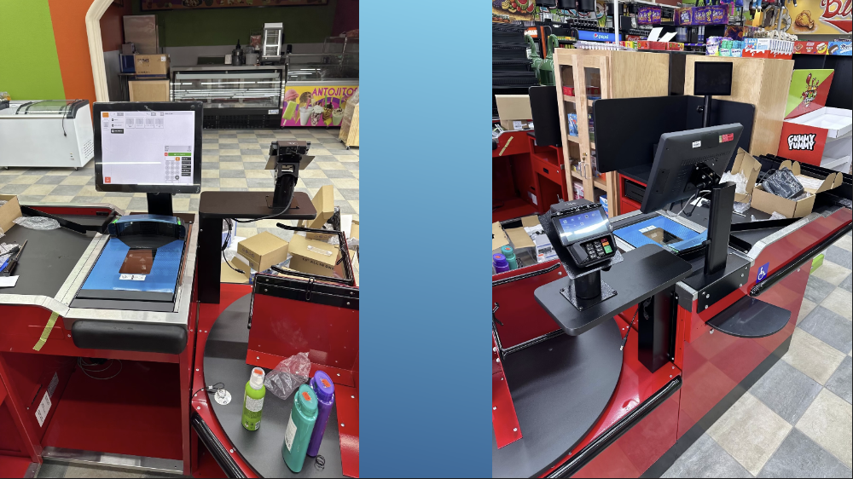

Slide 25
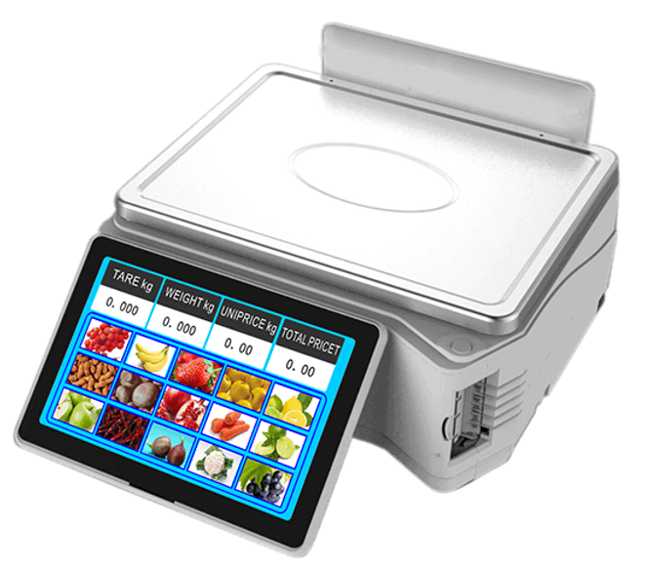
FEATURES
FUNCTIONALITIES:
Butcher Facing 15” Display
10” Customer Facing Display
Side Label printer
30 lb capacity
Windows based operating system
Capacitive touch, Flushed touchscreen
Department structure
Item categorization
Pagination capabilities
Product image
Customer tare, price and total charge disclosure
Cloud managed
Price embedded & weight embedded barcode printing.
Cumulative label printing
Item | Monthly Pricing
Label Printing Scale TS5 | $49.99/ Month

Slide 26
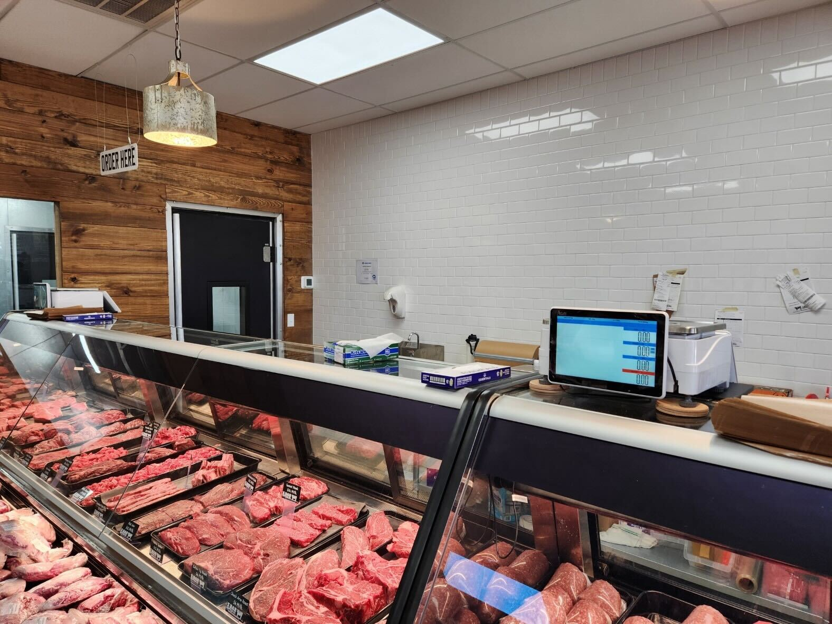

Slide 27
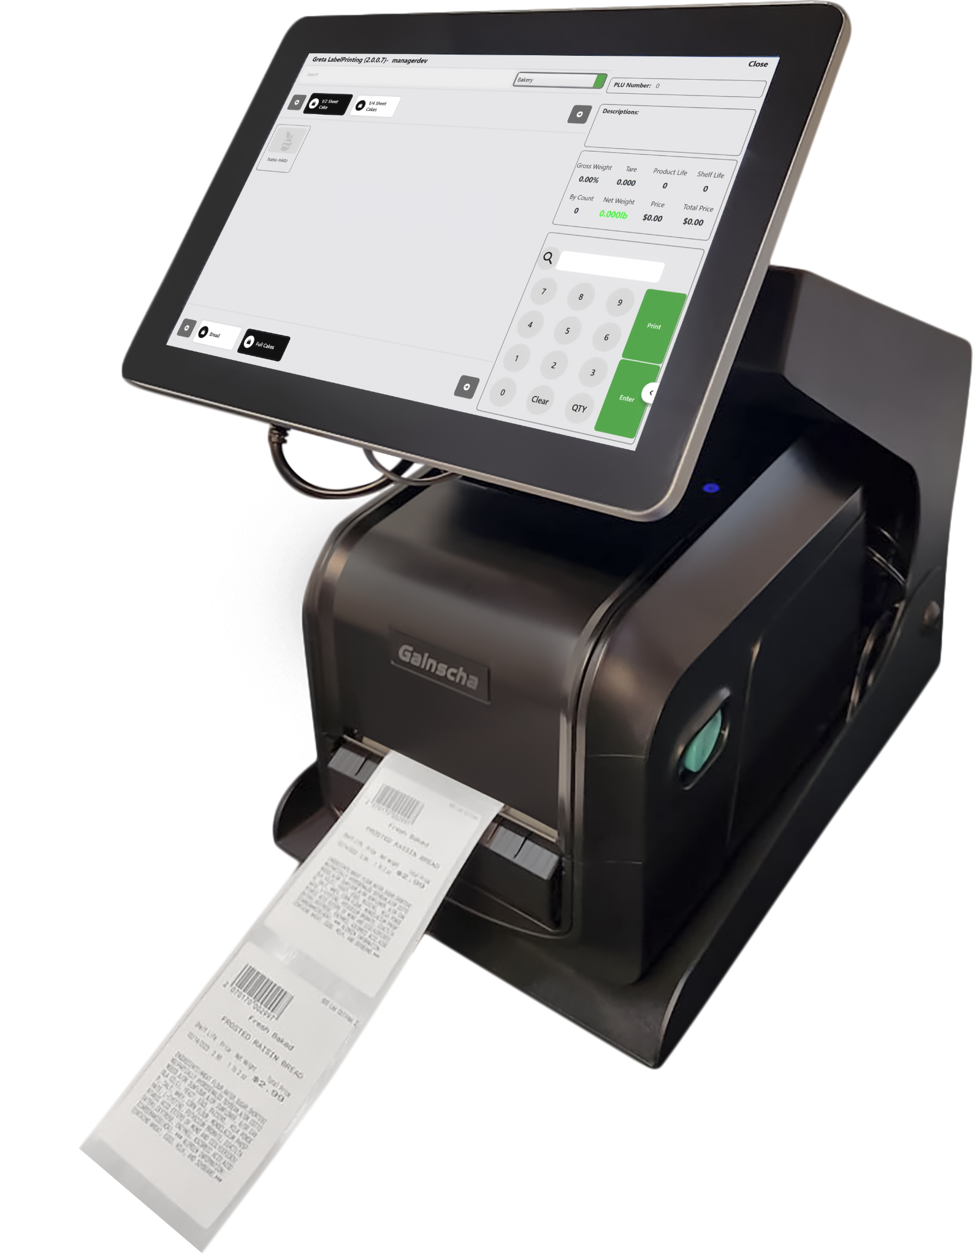
FEATURES
FUNCTIONALITIES:
User Facing 15” Display
Thermal production Label printer
Windows Based OS
Metal Housing for rough kitchen environments.
Optional 60 lbs Scale
Optional Industrial grade label printer
Flushed, Capacitive Touchscreen
Tare values assigned
Random, Fixed and By Count PLU type printing.
Departments Structure
Item Categorization
Inventory updater on production
PLU finder
Label Streaming
Tare & Print option
Multiple label options, including continuous label stock
Optional 60 lbs scale
Item | Monthly Pricing
Label Printing Station (No Scale) | $49.99/ Month
Label Printing Station (With Scale) | $79.99/ Month

Slide 28
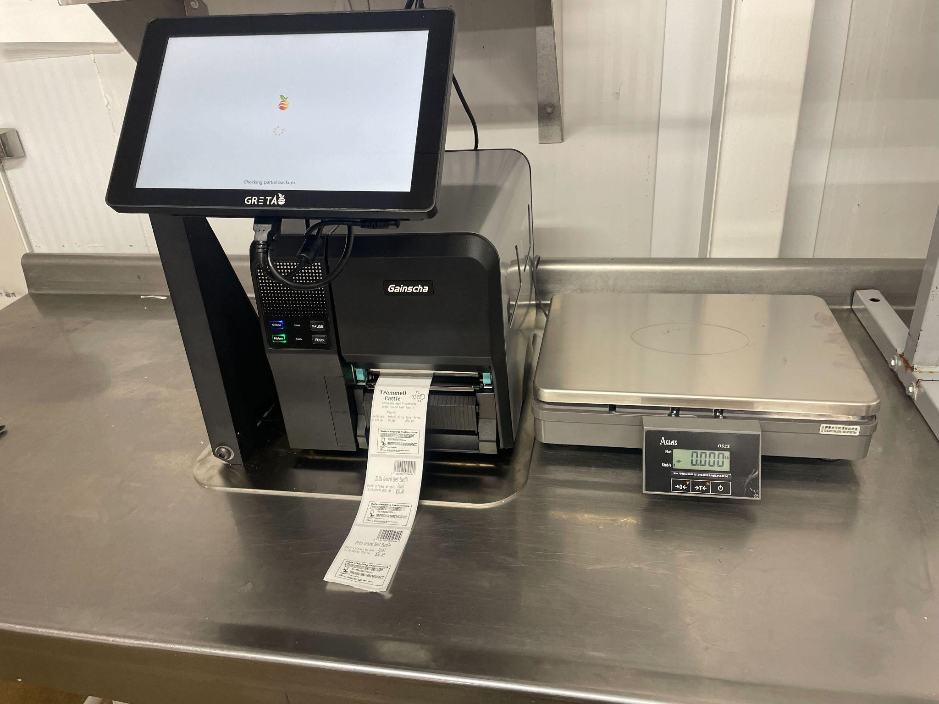

Slide 29
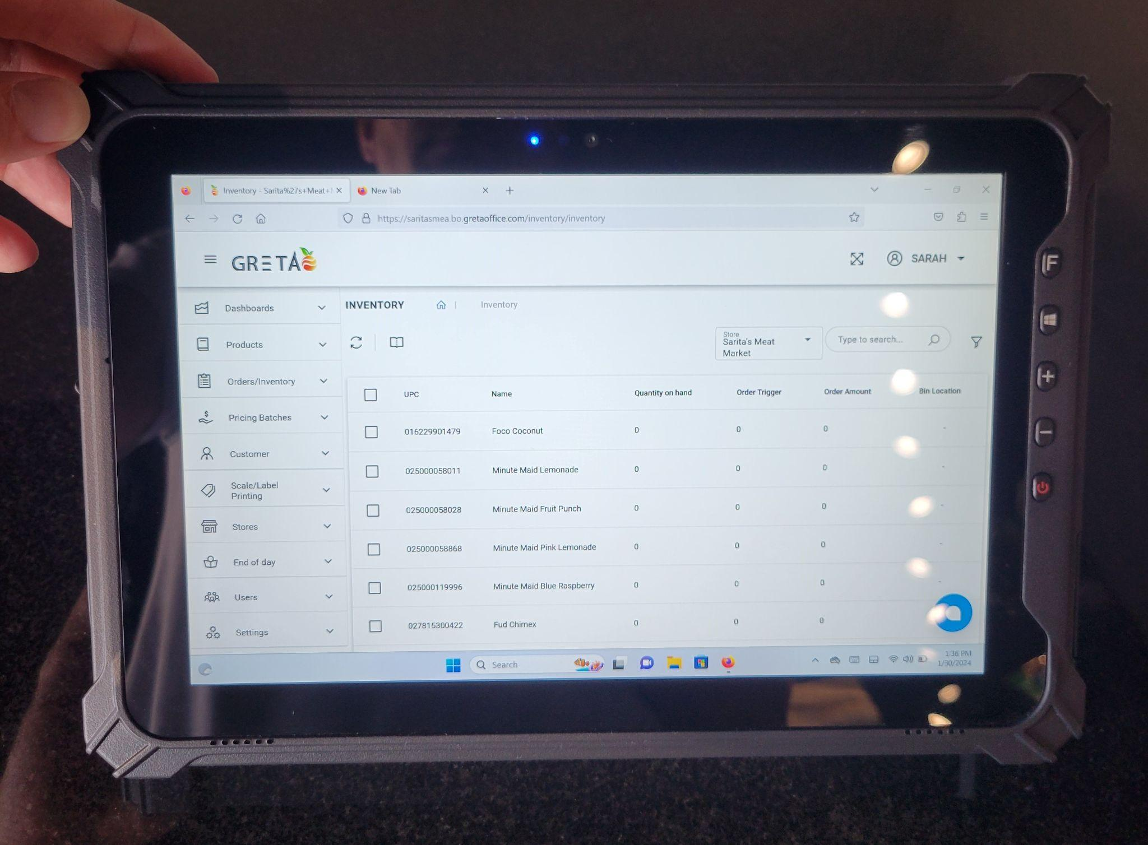
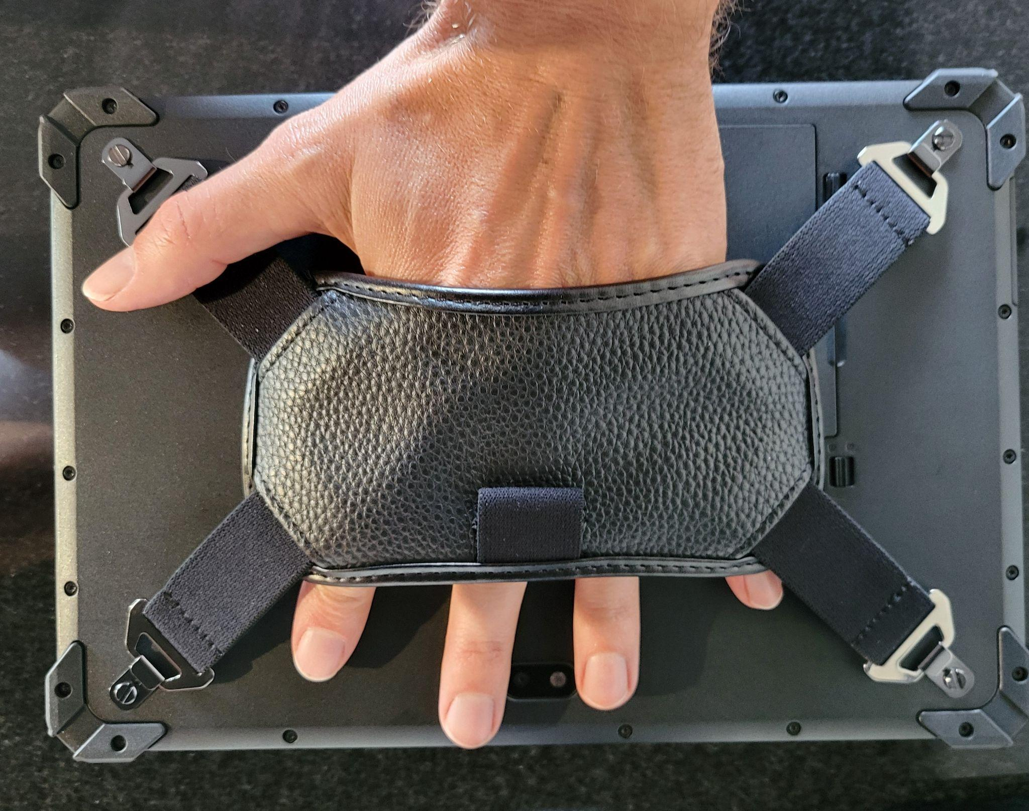
INVENTORY TABLET
Item | Monthly Pricing
7” Inventory Tablet | $19.99/ Month
10” Inventory Tablet | $29.99/ Month

Slide 30
Add on Hardware
Item | Monthly Pricing
Label Printer LP1 | 14.99/ Month
Shelf Tag Printer GA3406 | $9.99/ Month
USB/BT Scanner BT40D | $4.99/ Month
Cash Drawer- ECH410 | $4.99/ Month
PAX A30 | $14.99/ Month
60lb Weight Scale-OS2C | $29.99/ Month
GRETA Digital Computer | $9.99/ Month
10” Inventory Tablet I17J | $29.99/ Month
7” Inventory Tablet I62H | $19.99/ Month
Extra CD Till E410I | $1.99/ Month
2D Barcode Scan OD | $5.99/ Month
2D Presentation Scan OD4600 | $7.99/ Month
GRETA Label Print Scale TS5 | $49.99/ Month
GRETA Label Print Scale LS5 | $39.99/ Month

Slide 31
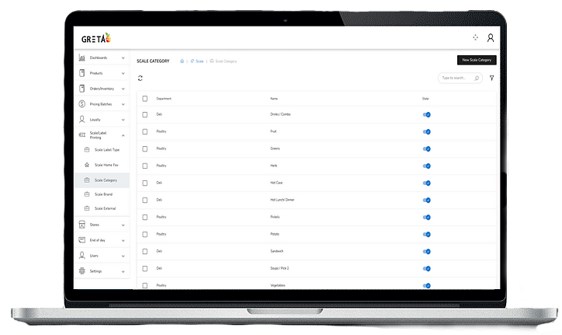
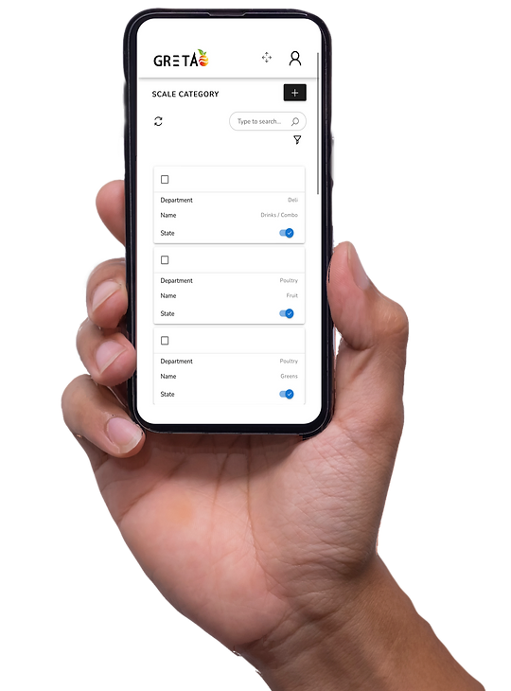
BACK OFFICE
Features/ Functionalities:
100% Cloud Native
Multi location management
Vendor Management
Product Families
Break Pack parenting setup
Multi Location inventory management
Label Design
Shelf Tag Design
Loyalty Program
Industry Specific reporting
Live Dashboards
Physical Inventory Counting
User Roles and Permissions
And Much more.

Slide 32
IMPLEMENTATION TIME FRAME
Week 1
(Back office build)
Week 2
(Inventory Review Call)
Week 4
(Shipping Period)
Week 2
(Inventory build)
Week 3
(Equipment order and Configuration)
Week 5
(installation & Training)
Disclosure:*As GRETA™ relies on the data in the system being accurate to perform at it designed best, please be mindful that implementation can be delayed if we do not have the correct information for equipment, item file, locations etc. We recommend 4-6 weeks to installation from the moment payment is collected.
Notes:
Week 1 (Back-office Build) After financing has completed the order for GRETA™ deployment & payment has been collected we will build Customer Databases in the cloud for all locations along with store configuration. *A signed purchase order is required in order to to begin implementation.
Week 2 (Inventory build)
Menu file, departments, categories, discounts etc will be built in the customers back office. *We require an inventory file for this stage of implementation in .CSV format. Failure to provide inventory file will cause delays in installation.
Week 2 Inventory Review Call: Inventory review call with client to get clearance to deploy. *Required to deploy systems
Week 3 (Equipment order and Configuration)
Equipment ordered from warehouse, equipment sync, download and configuration for all applications. POS, LPS, Scale Comm.
Week 4 (Shipping Period)
Shipping is usually about 7 business days. Expedited shipping is available on case by case at current shipping rates
Week 4 (Shipping Period)
Shipping is usually about 7 business days. Expedited shipping is available on case by case at current shipping rates
Week 5 (installation & Training)
After equipment arrives, installers will install equipment and get it ready for training. Training will be done virtually or in person based on the client’s preference

